Slide 1

COMP 4603
Advanced C++
Session #1: Intro & Class in C++

Slide 2

Welcome to COMP 4603

Slide 3
Course Outline
Course outline link is in Learning Hub

Slide 4
Procedural And Object-oriented Programming
Procedural programming focuses on the process/actions that occur in a program
Object-Oriented programming is based on the data and the functions that operate on it. Objects are instances of ADTs that represent the data and its functions

Slide 5
Limitations Of Procedural Programming
If the data structures change, many functions must also be changed
Programs that are based on complex function hierarchies are:
difficult to understand and maintain
difficult to modify and extend
easy to break

Slide 6

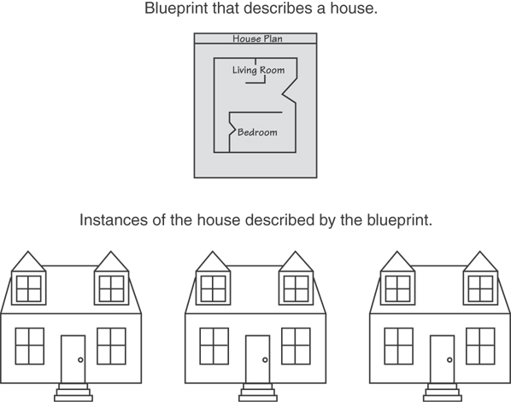
Object-oriented Programming Terminology
class: like a struct (allows bundling of related variables), but variables and functions in the class can have different properties than in a struct
object: an instance of a class, in the same way that a variable can be an instance of a struct
A Class is like a blueprint and objects are like houses built from the blueprint

Slide 7
Object-oriented Programming Terminology
attributes: members of a class
methods or behaviors: member functions of a class
data hiding: restricting access to certain members of an object
public interface: members of an object that are available outside of the object. This allows the object to provide access to some data and functions without sharing its internal details and design, and provides some protection from data corruption

Slide 8
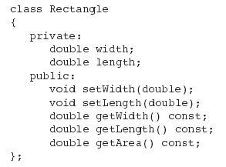
Class Definition
Objects are created from a class
Format:
class ClassName
{
declaration;
declaration;
};
Example:

Slide 9
Access Specifiers
Used to control access to members of the class
public: can be accessed by functions outside of the class
private: can only be called by or accessed by functions that are members of the class

Slide 10
Class Example
Private Members
Public Members

Slide 11
More On Access Specifiers
Can be listed in any order in a class
Can appear multiple times in a class
If not specified, the default is private

Slide 12

Using const With Member Functions
const appearing after the parentheses in a member function declaration specifies that the function will not change any data in the calling object.

Slide 13
Defining A Member Function
When defining a member function:
Put prototype in class declaration
Define function using class name and scope resolution operator (::)
int Rectangle::setWidth(double w)
{
width = w;
}

Slide 14
Accessors And Mutators
Mutator: a member function that stores a value in a private member variable, or changes its value in some way
Accessor: function that retrieves a value from a private member variable. Accessors do not change an object's data, so they should be marked const.

Slide 15
Defining An Instance Of A Class
An object is an instance of a class
Defined like structure variables:
Rectangle r;
Access members using dot operator:
r.setWidth(5.2);
cout << r.getWidth();
Compiler error if attempt to access private member using dot operator

Slide 16
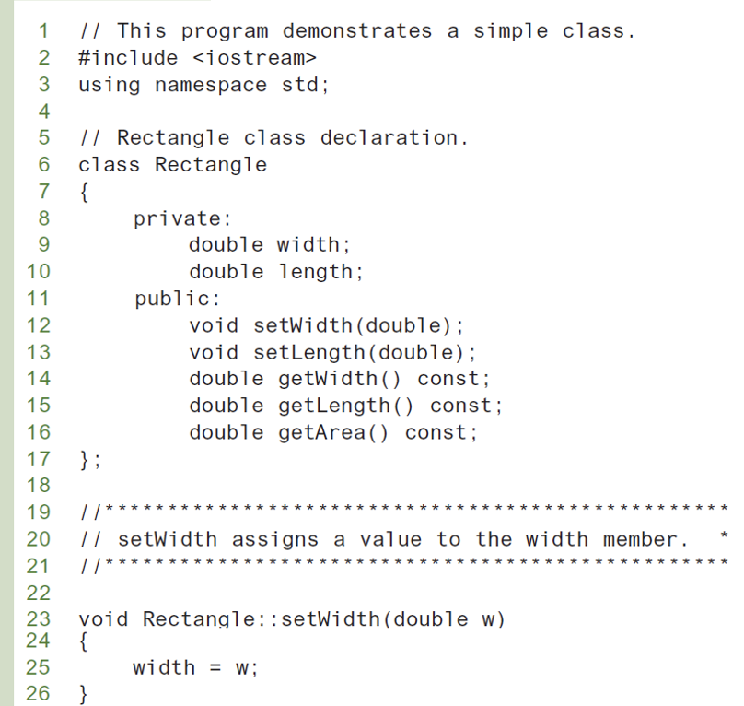

Slide 17
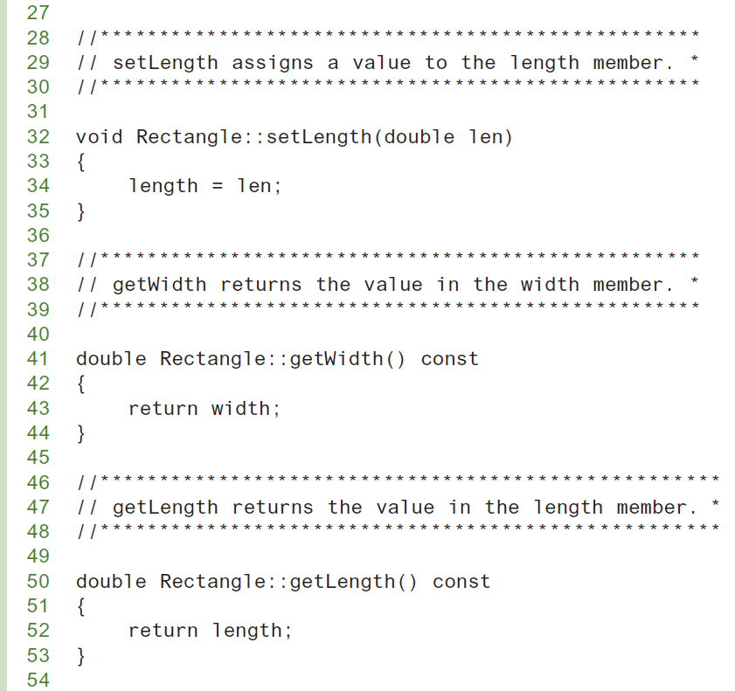
Program (Continued)

Slide 18
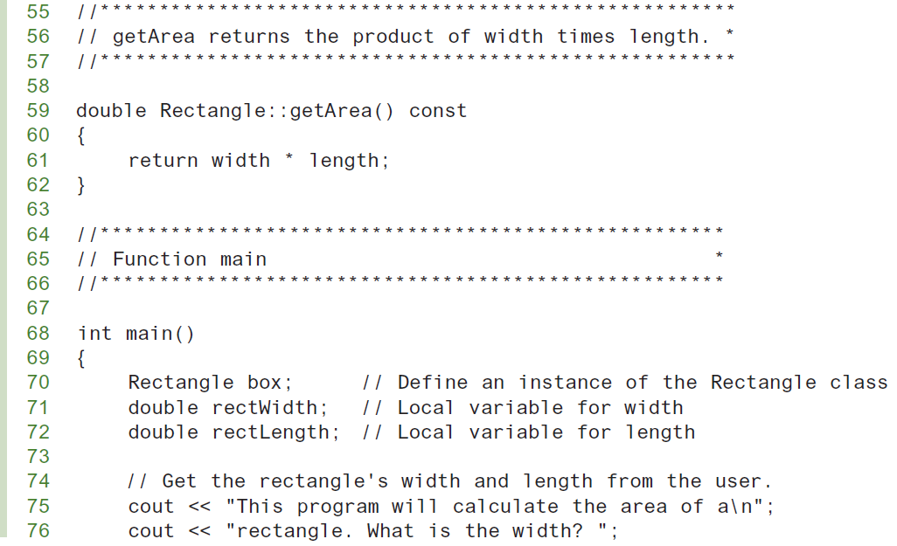
Program (Continued)

Slide 19
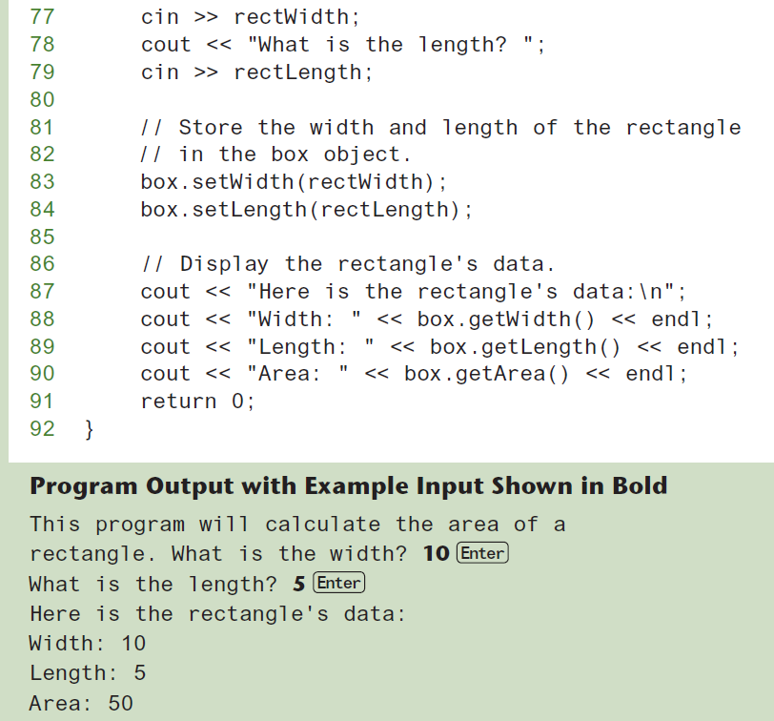
Program (Continued)

Slide 20
Avoiding Stale Data
Some data is the result of a calculation.
In the Rectangle class the area of a rectangle is calculated.
length x width
If we were to use an area variable here in the Rectangle class, its value would be dependent on the length and the width.
If we change length or width without updating area, then area would become stale.
To avoid stale data, it is best to calculate the value of that data within a member function rather than store it in a variable.

Slide 21
Pointer To An Object
Can define a pointer to an object:
Rectangle *rPtr = nullptr;
Can access public members via pointer:
rPtr = &otherRectangle;
rPtr->setLength(12.5);
cout << rPtr->getLength() << endl;

Slide 22
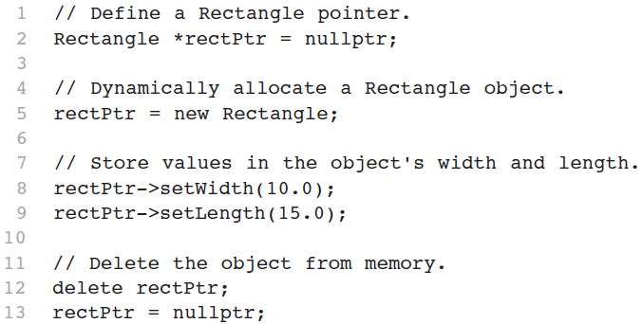
Dynamically Allocating An Object
We can also use a pointer to dynamically allocate an object.

Slide 23
Why Have Private Members?
Making data members private provides data protection
Data can be accessed only through public functions
Public functions define the class’s public interface

Slide 24
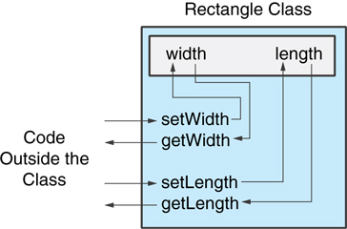
Why Have Private Members?
Making data members private provides data protection
Data can be accessed only through public functions
Public functions define the class’s public interface
Code outside the class must use the
class's public member functions
to interact with the object.

Slide 25
Separating Specification From Implementation
Place class declaration in a header file that serves as the class specification file. Name the file ClassName.h, for example, Rectangle.h
Place member function definitions in ClassName.cpp, for example, Rectangle.cpp File should #include the class specification file
Programs that use the class must #include the class specification file, and be compiled and linked with the member function definitions

Slide 26
Inline Member Functions
Member functions can be defined
inline: in class declaration
after the class declaration
Inline appropriate for short function bodies:
int getWidth() const { return width; }

Slide 27
Rectangle Class With Inline Member Functions
1 // Specification file for the Rectangle class 2 // This version uses some inline member functions. 3 #ifndef RECTANGLE_H 4 #define RECTANGLE_H 5 6 class Rectangle 7 { 8 private: 9 double width; 10 double length; 11 public: 12 void setWidth(double); 13 void setLength(double); 14 15 double getWidth() const 16 { return width; } 17 18 double getLength() const 19 { return length; } 20 21 double getArea() const 22 { return width * length; } 23 }; 24 #endif

Slide 28
Tradeoffs – Inline Vs. Regular Member Functions
Regular functions – when called, compiler stores return address of call, allocates memory for local variables, etc.
Code for an inline function is copied into program in place of call – larger executable program, but no function call overhead, hence faster execution

Slide 29
Constructors
Member function that is automatically called when an object is created
Purpose is to construct an object
Constructor function name is class name
Has no return type

Slide 30
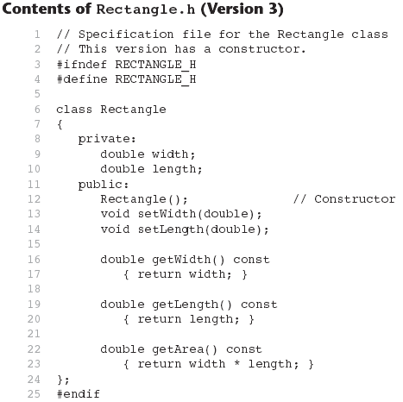

Slide 31
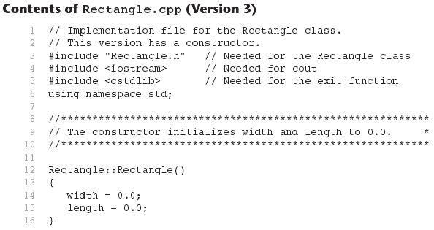
Continues...

Slide 32
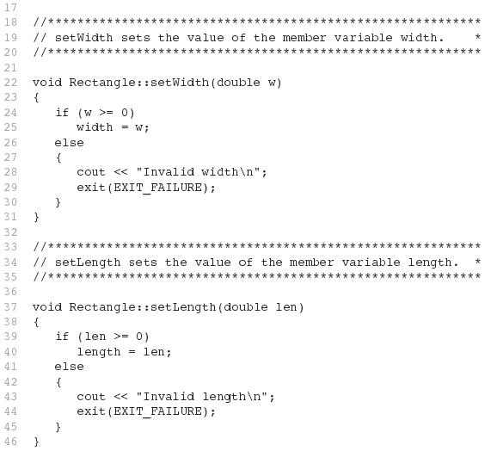
Contents of Rectangle.ccp Version 3
(continued)

Slide 33
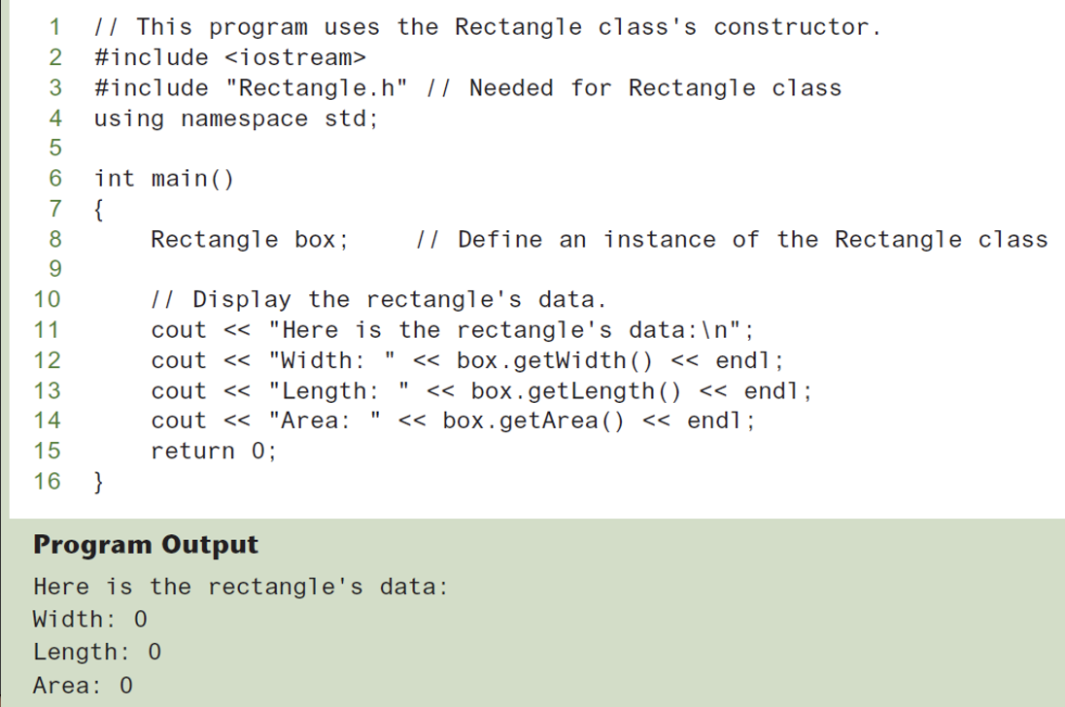

Slide 34
In-place Initialization
For C++11 and later, you can initialize a member variable in its declaration statement, just as you can with a regular variable.
This is known as in-place initialization. Here is an example:
class Rectangle
{
private:
double width = 0.0;
double length = 0.0;
public:
Public member functions appear here…
};

Slide 35
Default Constructors
A default constructor is a constructor that takes no arguments.
If you write a class with no constructor at all, C++ will write a default constructor for you, one that does nothing.
A simple instantiation of a class (with no arguments) calls the default constructor:
Rectangle r;

Slide 36
Passing Arguments To Constructors
To create a constructor that takes arguments:
indicate parameters in prototype: Rectangle(double, double);
Use parameters in the definition: Rectangle::Rectangle(double w, double len) { width = w; length = len; }
You can pass arguments to the constructor when you create an object: Rectangle r(10, 5);

Slide 37
More About Default Constructors
If all of a constructor's parameters have default arguments, then it is a default constructor. For example:
Rectangle(double = 0, double = 0);
Creating an object and passing no arguments will cause this constructor to execute: Rectangle r;

Slide 38
Classes With No Default Constructor
When all of a class's constructors require arguments, then the class has NO default constructor.
When this is the case, you must pass the required arguments to the constructor when creating an object.

Slide 39
Destructors
Member function automatically called when an object is destroyed
Destructor name is ~classname, e.g., ~Rectangle
Has no return type; takes no arguments
Only one destructor per class, i.e., it cannot be overloaded
If constructor allocates dynamic memory, destructor should release it

Slide 40
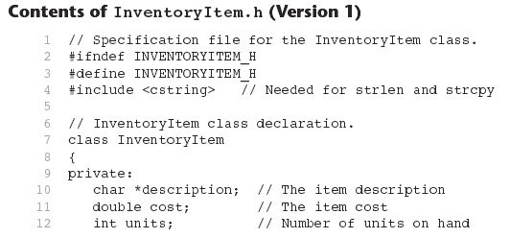

Slide 41
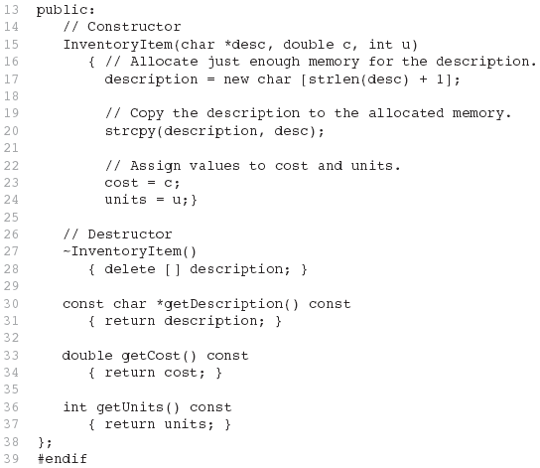
Contents of InventoryItem.h Version1
(continued)

Slide 42
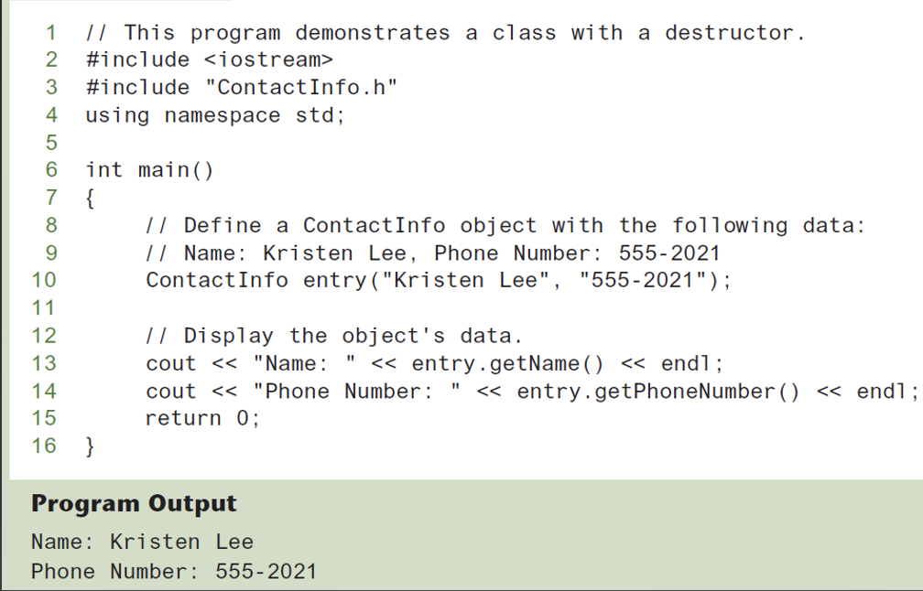

Slide 43
Constructors, Destructors, And Dynamically Allocated Objects
When an object is dynamically allocated with the new operator, its constructor executes: Rectangle *r = new Rectangle(10, 20);
When the object is destroyed, its destructor executes: delete r;

Slide 44
Overloading Constructors
A class can have more than one constructor
Overloaded constructors in a class must have different parameter lists:
Rectangle(); Rectangle(double);
Rectangle(double, double);

Slide 45
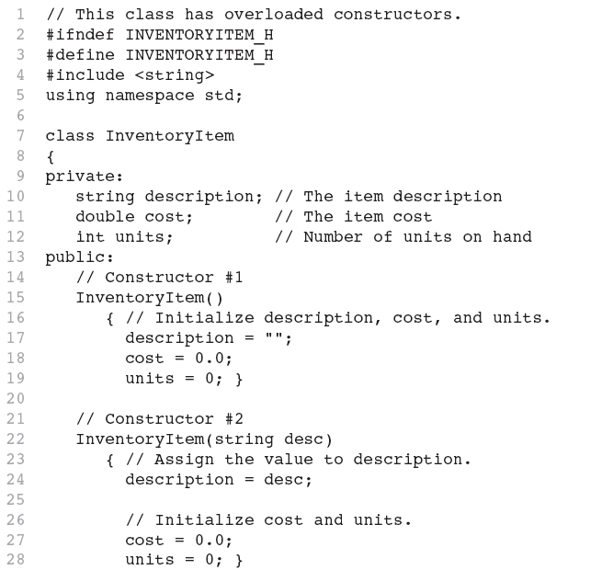
Continues...

Slide 46
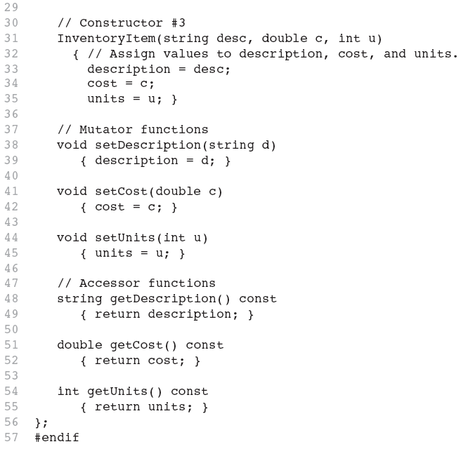

Slide 47
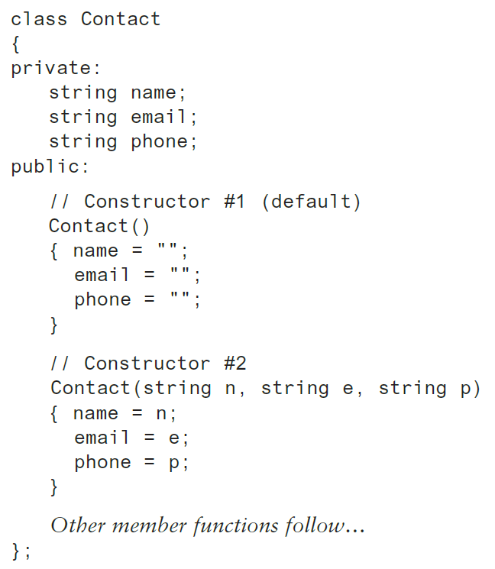
Constructor Delegation
Sometimes a class will have multiple constructors that perform a similar set of steps. For example, look at the following Contact class:

Slide 48
Constructor Delegation
Both constructors perform a similar operation: They assign values to the name, email, and phone member variables.
The default constructor assigns empty strings to the members, and the parameterized constructor assigns specified values to the members.

Slide 49
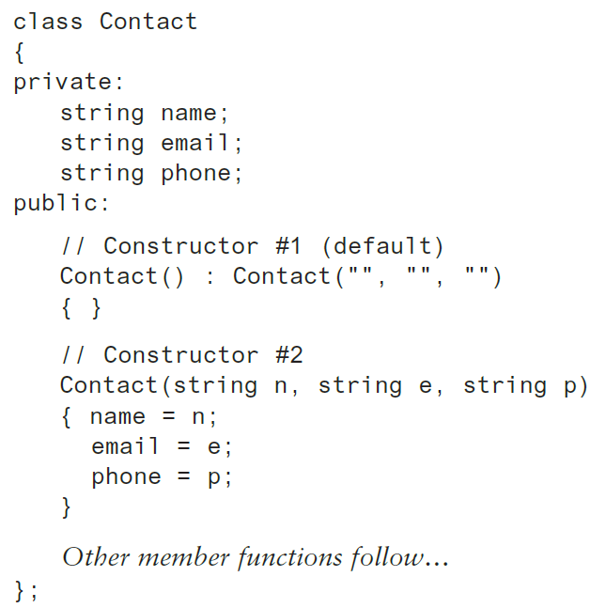
Constructor Delegation
In C++ 20, it is possible for one constructor to call another constructor in the same class.
This is known as constructor delegation.

Slide 50
Only One Default Constructor & One Destructor
Do not provide more than one default constructor for a class: one that takes no arguments and one that has default arguments for all parameters
Square();
Square(int = 0); // will not compile
Since a destructor takes no arguments, there can only be one destructor for a class

Slide 51
Member Function Overloading
Non-constructor member functions can also be overloaded:
void setCost(double);
void setCost(char *);
Must have unique parameter lists as for constructors

Slide 52
Using Private Member Functions
A private member function can only be called by another member function
It is used for internal processing by the class, not for use outside of the class
Notes:
See the createDescription function in ContactInfo.h (Version 2)

Slide 53
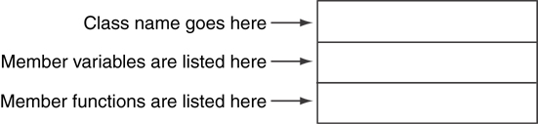
The Unified Modeling Language (UML)
The UML provides a set of standard diagrams for graphically depicting object-oriented systems
A UML diagram for a class has three main sections.

Slide 54
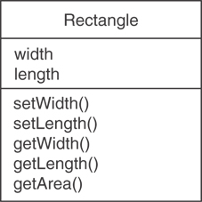
Example: A Rectangle Class
class Rectangle
{
private:
double width;
double length;
public:
bool setWidth(double);
bool setLength(double);
double getWidth() const;
double getLength() const;
double getArea() const;
};

Slide 55
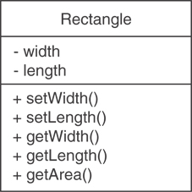
UML Access Specification Notation
In UML you indicate a private member with a minus (-) and a public member with a plus(+).
These member variables are private.
These member functions are public.

Slide 56
UML Data Type Notation
To indicate the data type of a member variable, place a colon followed by the name of the data type after the name of the variable.
- width : double
- length : double

Slide 57
UML Parameter Type Notation
To indicate the data type of a function’s parameter variable, place a colon followed by the name of the data type after the name of the variable.
+ setWidth(w : double)

Slide 58
UML Function Return Type Notation
To indicate the data type of a function’s return value, place a colon followed by the name of the data type after the function’s parameter list.
+ setWidth(w : double) : void

Slide 59
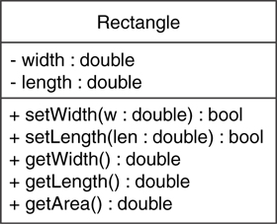
The Rectangle Class

Slide 60
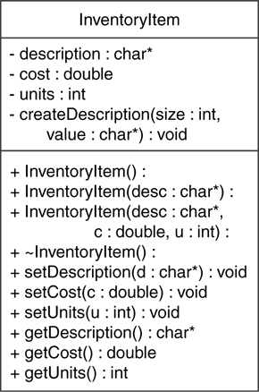
Showing Constructors And Destructors
No return type listed for constructors or destructors
Constructors
Destructor

Slide 61
Instance And Static Members
instance variable: a member variable in a class. Each object has its own copy.
static variable: one variable shared among all objects of a class
static member function: can be used to access static member variable; can be called before any objects are defined

Slide 62
static Member Variable
Contents of Tree.h
1 // Tree class 2 class Tree 3 { 4 private: 5 static int objectCount; // Static member variable. 6 public: 7 // Constructor 8 Tree() 9 { objectCount++; } 10 11 // Accessor function for objectCount 12 int getObjectCount() const 13 { return objectCount; } 14 }; 15 16 // Definition of the static member variable, written 17 // outside the class. 18 int Tree::objectCount = 0;
Static member declared here.
Static member defined here.

Slide 63
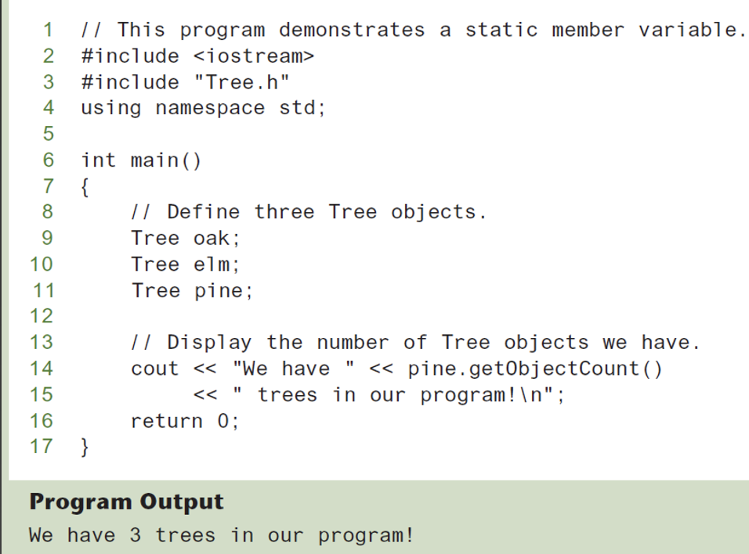

Slide 64
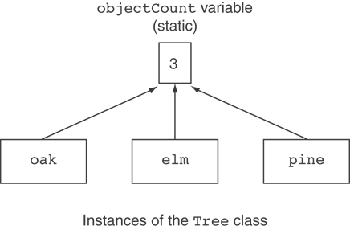
Three Instances Of The Tree Class, But Only One Objectcount Variable

Slide 65
static Member Function
Declared with static before return type:
static int getObjectCount() const
{ return objectCount; }
Static member functions can only access static member data
Can be called independent of objects: int num = Tree::getObjectCount();

Slide 66
Modified Version of Tree.h
1 // Tree class 2 class Tree 3 { 4 private: 5 static int objectCount; // Static member variable. 6 public: 7 // Constructor 8 Tree() 9 { objectCount++; } 10 11 // Accessor function for objectCount 12 static int getObjectCount() const 13 { return objectCount; } 14 }; 15 16 // Definition of the static member variable, written 17 // outside the class. 18 int Tree::objectCount = 0;
Now we can call the function like this: cout << "There are " << Tree::getObjectCount() << " objects.\n";

Slide 67
friends Of Classes
friend: a function or class that is not a member of a class, but has access to private members of the class
A friend function can be a stand-alone function or a member function of another class
It is declared a friend of a class with friend keyword in the function prototype

Slide 68
friend Function Declarations
Stand-alone function:
friend void setAVal(intVal&, int);
// declares setAVal function to be
// a friend of this class
Member function of another class:
friend void SomeClass::setNum(int num)
// setNum function from SomeClass
// class is a friend of this class

Slide 69
friend Class Declarations
Class as a friend of a class:
class FriendClass
{
...
};
class NewClass
{
public:
friend class FriendClass; // declares
// entire class FriendClass as a friend
// of this class
…
};

Slide 70
Member-wise Assignment
Can use = to assign one object to another, or to initialize an object with an object’s data
Copies member to member. e.g.,
instance2 = instance1; means:
copy all member values from instance1 and assign to the corresponding member variables of instance2
Use at initialization:
Rectangle r2 = r1;

Slide 71
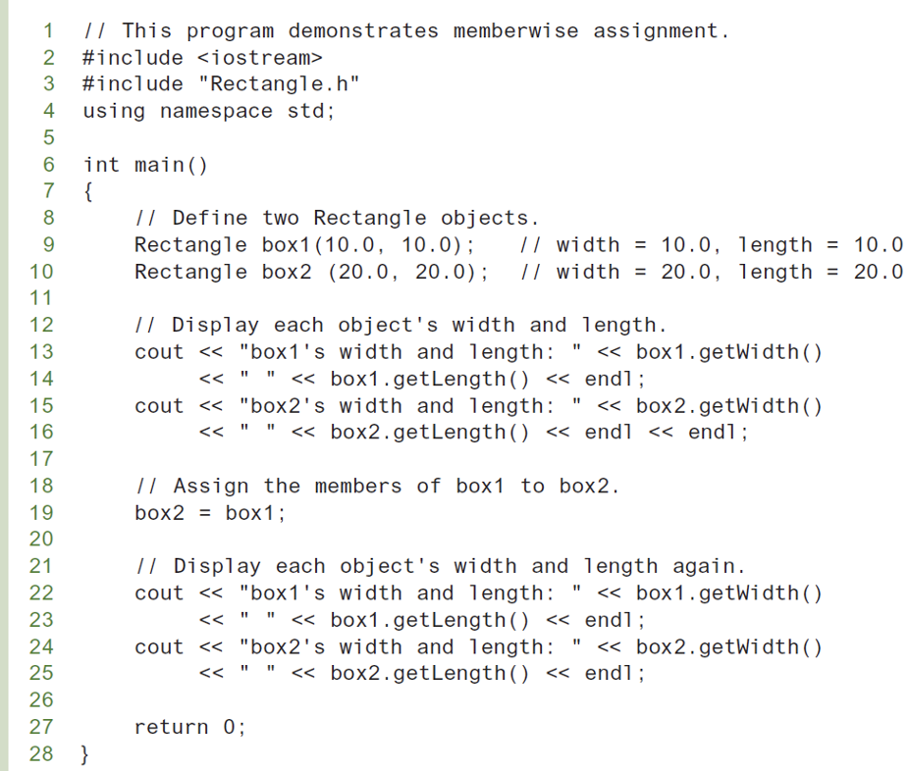

Slide 72
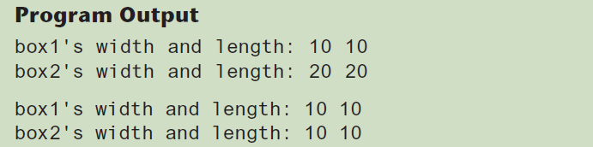

Slide 73
Copy Constructors
Special constructor used when a newly created object is initialized to the data of another object of same class
Default copy constructor copies field-to-field
Default copy constructor works fine in many cases

Slide 74
Copy Constructors
Problem: what if object contains a pointer?
class SomeClass
{ public:
SomeClass(int val = 0)
{value=new int; *value = val;}
int getVal();
void setVal(int);
private:
int *value;
}

Slide 75
Copy Constructors
What we get using member-wise copy with objects containing dynamic memory:
SomeClass object1(5);
SomeClass object2 = object1;
object2.setVal(13);
cout << object1.getVal(); // also 13
13
object1
object2
value
value

Slide 76
Programmer-defined Copy Constructor
Allows us to solve problem with objects containing pointers:
SomeClass::SomeClass(const SomeClass &obj)
{
value = new int;
*value = obj.value;
}
Copy constructor takes a reference parameter to an object of the class

Slide 77
Programmer-defined Copy Constructor
Each object now points to separate dynamic memory:
SomeClass object1(5);
SomeClass object2 = object1;
object2.setVal(13);
cout << object1.getVal(); // still 5
5
13
object1
object2
value
value

Slide 78
Programmer-defined Copy Constructor
Since copy constructor has a reference to the object it is copying from,
SomeClass::SomeClass(SomeClass &obj)
it can modify that object.
To prevent this from happening, make the object parameter const:
SomeClass::SomeClass(const SomeClass &obj)

Slide 79
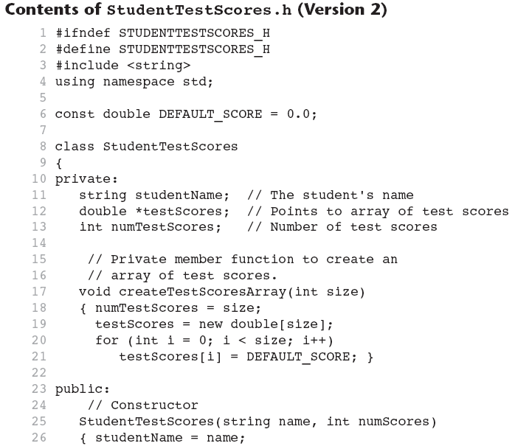

Slide 80
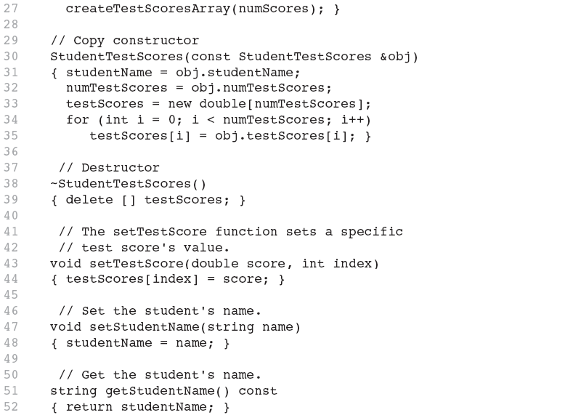

Slide 81
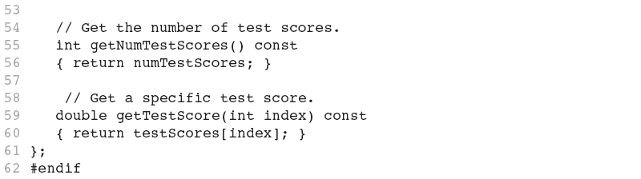

Slide 82
Operator Overloading
Operators such as =, +, and others can be redefined when used with objects of a class
The name of the function for the overloaded operator is operator followed by the operator symbol, e.g.,
operator+ to overload the + operator, and
operator= to overload the = operator
Prototype for the overloaded operator goes in the declaration of the class that is overloading it
Overloaded operator function definition goes with other member functions

Slide 83
The this Pointer
this: predefined pointer available to a class’s member functions
Always points to the instance (object) of the class whose function is being called
Is passed as a hidden argument to all non-static member functions

Slide 84
The this Pointer
Example, student1 and student2 are both StudentTestScores objects.
The following statement causes the getStudentName member function to operate on student1: cout << student1.getStudentName() << endl;
When getStudentName is operating on student1, the this pointer is pointing to student1.

Slide 85
The this Pointer
Likewise, the following statement causes the getStudentName member function to operate on student2: cout << student2.getStudentName() << endl;
When getStudentName is operating on student2, the this pointer is pointing to student2.
The this pointer always points to the object that is being used to call the member function.

Slide 86
Operator Overloading
Prototype:
void operator=(const SomeClass &rval)
Operator is called via object on left side
parameter for
object on right
side of operator
return
type
function
name

Slide 87
Invoking An Overloaded Operator
Operator can be invoked as a member function:
object1.operator=(object2);
It can also be used in more conventional manner:
object1 = object2;

Slide 88
Returning A Value
Overloaded operator can return a value
class Point2d
{
private:
int x, y;
...
public:
double operator-(const point2d &right)
{ return sqrt(pow((x-right.x),2)
+ pow((y-right.y),2)); }
};
Point2d point1(2,2), point2(4,4);
// Compute and display distance between 2 points.
cout << point2 – point1 << endl; // displays 2.82843

Slide 89
Returning A Value
Return type the same as the left operand supports notation like:
object1 = object2 = object3;
Function declared as follows:
const SomeClass operator=(const someClass &rval)
In function, include as last statement:
return *this;

Slide 90
Notes On Overloaded Operators
Can change meaning of an operator
Cannot change the number of operands of the operator
Only certain operators can be overloaded. Cannot overload the following operators:
?: . .* :: sizeof

Slide 91
Overloading Types Of Operators
++, -- operators overloaded differently for prefix vs. postfix notation
Overloaded relational operators should return a bool value
Overloaded stream operators >>, << must return reference to istream, ostream objects and take istream, ostream objects as parameters

Slide 92
Overloaded [] Operator
Can create classes that behave like arrays, provide bounds-checking on subscripts
Must consider constructor, destructor
Overloaded [] returns a reference to object, not an object itself

Slide 93
Object Conversion
Type of an object can be converted to another type
Automatically done for built-in data types
Must write an operator function to perform conversion
To convert an FeetInches object to an int:
FeetInches::operator int() {return feet;}
Assuming distance is a FeetInches object, allows statements like:
int d = distance;

Slide 94
Aggregation
Aggregation: a class is a member of a class
Supports the modeling of ‘has a’ relationship between classes – enclosing class ‘has a’ enclosed class
Same notation as for structures within structures

Slide 95
Aggregation
class StudentInfo
{
private:
string firstName, LastName;
string address, city, state, zip;
...
};
class Student
{
private:
StudentInfo personalData;
...
};

Slide 96
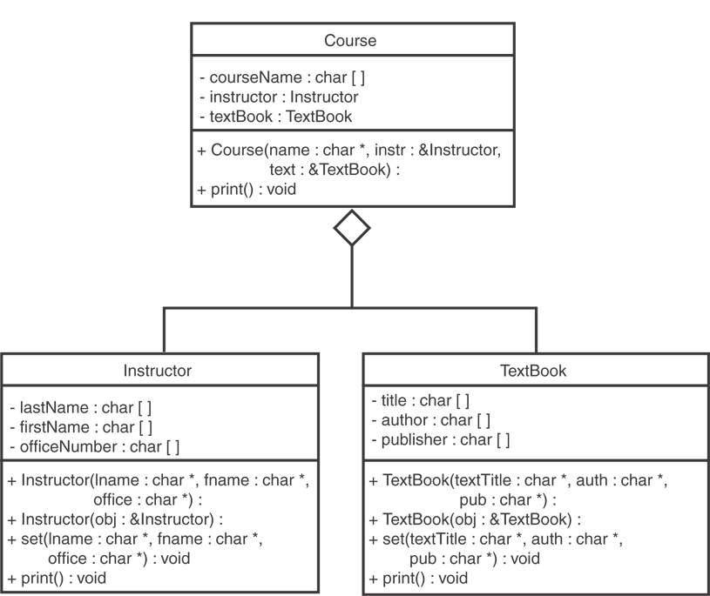

Slide 97
Temporary Values
Consider this code: int x; x = 2 * 6;
When the expression 2 * 6 is evaluated, the value 12 is stored in memory as a temporary value.
The temporary value is then stored in the x variable.
Then, the temporary value is discarded.

Slide 98
Temporary Values
Consider this: 1 int square(int a) 2 { 3 return a * a; 4 } 5 6 int main() 7 { 8 int x = 0; 9 10 x = square(5); 11 cout << x << endl; 12 return 0; 13 }
The square function is called, and the value 5 is passed as an argument.
The square function calculates 5 * 5 and stores the result, 25, as a temporary value.
The temporary value is copied (assigned) to the variable x.
The temporary value is no longer needed, so the system discards it.

Slide 99
lvalues And rvalues
Two types of values stored in memory during the execution of a program:
Values that persist beyond the statement that created them and have names that make them accessible to other statements in the program. In C++, these values are called lvalues.
Values that are temporary and cannot be accessed beyond the statement that created them. In C++, these values are called rvalues.

Slide 100
rvalue References
rvalue Reference: a reference variable that can refer only to temporary objects that would otherwise have no name.
Rvalue references are used to write move constructors and move assignment operators (otherwise known as move semantics).
Anytime you write a class with a pointer or reference to a piece of data outside the class, you should implement move semantics.
Move semantics increase the performance of these types of classes.

Slide 101
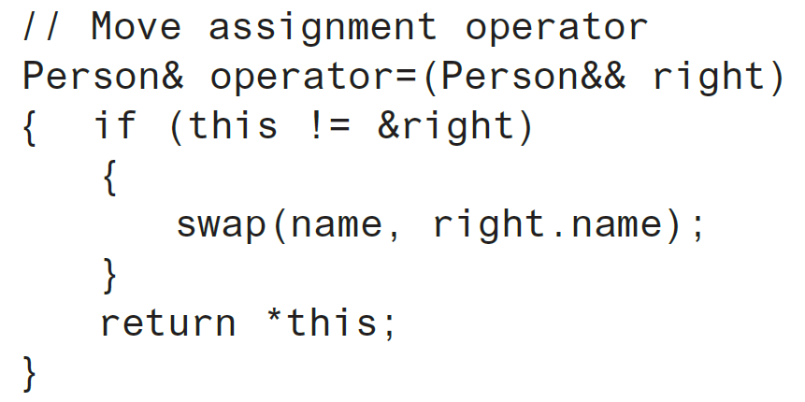
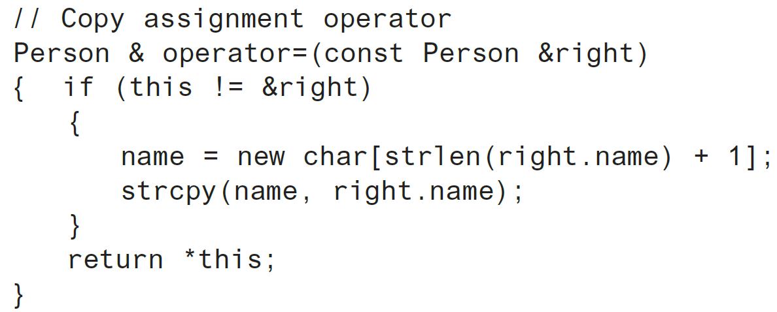
move Assignment vs. copy Assignment
From the Person class:

Slide 102
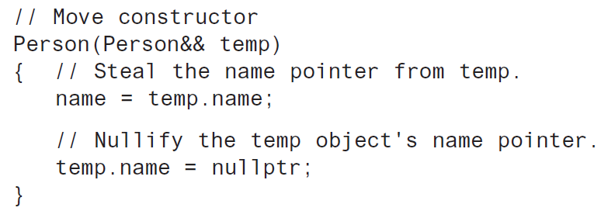
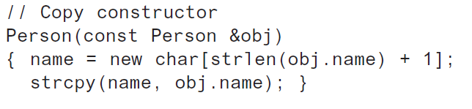
Move Constructor Vs. Copy Constructor
From the Person class:

Slide 103
When To Implement Move Semantics
In any class that contains a pointer or reference to an outside piece of data, the class should also have:
copy constructor
move constructor
copy assignment operator
move assignment operator

Slide 104
Default Operations
Consider this class:
The compiler will automatically generate:
A default constructor MyClass()
A copy constructor MyClass(const MyClass &)
A copy assignment operator MyClass & operator=(const Myclass &)
A move constructor MyClass(MyClass &&)
A destructor ~MyClass()
class MyClass
{
private:
int mydata = 0;
public:
int getMyData()
{ return mydata; }
void setMyData(int d)
{ mydata = d; }
};

Slide 105
Default Operations
If you write any of these in a class, the compiler will not provide any default versions of these functions:
Default constructor
Copy constructor
Copy Assignment Operator
Move Constructor
Destructor

Slide 106
The default Keyword
You can use the default keyword to declare which default operations that you want the compiler to automatically provide

Slide 107
The default Keyword
1 class MyClass 2 { 3 private: 4 int mydata = 0; 5 6 public: 7 // Constructors provided by default 8 MyClass() = default; 9 MyClass(const MyClass&) = default; 10 MyClass(MyClass&&) = default; 11 12 // Parameterized constructor 13 MyClass(int n) 14 { mydata = n; } 15 16 // Destructor 17 ~MyClass() = default; 18 19 // Copy assignment operator 20 MyClass& operator=(const MyClass&) = default; 21 22 // Accessor 23 int getMyData() const 24 { return mydata; } 25 26 // Mutator 27 void setMyData(int d) 28 { mydata = d; } 29 };
Generates a default constructor
Generates a default copy constructor
Generates a default move constructor
Generates a default destructor
Generates a default copy assignment operator

Slide 108
The delete Keyword
You can use the delete keyword to declare which default operations you do not want the compiler to automatically provide

Slide 109
The delete Keyword
1 class MyClass 2 { 3 private: 4 int mydata = 0; 5 6 public: 7 // Constructors provided by default 8 MyClass() = default; 9 MyClass(const MyClass&) = delete; 10 MyClass(MyClass&&) = delete; 11 12 // Parameterized constructor 13 MyClass(int n) 14 { mydata = n; } 15 16 // Destructor 17 ~MyClass() = default; 18 19 // Deleted copy assignment operator 20 MyClass& operator=(const MyClass&) = delete; 21 22 // Accessor 23 int getMyData() const 24 { return mydata; } 25 26 // Mutator 27 void setMyData(int d) 28 { mydata = d; } 29 };
Specifies no default copy constructor
Specifies no default move constructor
Specifies no default copy assignment operator
As a result of these declarations, MyClass objects cannot be copied by a constructor or by an assignment operation.

